Slide 1

Aditya Case Study Assessment :
Industry Standard Templates for Deliverables (use as reference)

Slide 2

Business Objective, Understanding and Approach
Business Objective
Understanding
Business Objective
Understanding
ILLUSTRATION
Approach
Approach

Slide 3
Analysis/ Modeling Methodology
Data Preparation & EDA
Variable Creation and Selection
Model Development
Model Performance Testing
Sub-setting (keeping relevant variables/records, e.g. time duration
…
Extensive bi-variate analysis conducted on all meaningful variables
…
20+ new variables created as a part of feature engineering
Use one-hot encoding to create dummy variables
…
Random Forest chosen as the preferred modeling technique since…
…
Developed 10+ candidate models
Highest Model accuracy observed of 78%
Conducted k-cross validation for k=7
Model performance also assessed on a hold-out sample of size 30% of the original dataset
…
ILLUSTRATION

Slide 4
Extended Data Dictionary (EDD)
 | Variable Type | Min | Pc 1% | Pc 5% | Pc 25% | Pc 50% | Mean | Pc 75% | Pc 95% | Pc 99% | Max | % Missing values | % Unique values
Variable 1 | Numeric
Variable 2 | Numeric
Variable 3 | Object
… | …
Variable n | Object
ILLUSTRATION
Findings from EDD :
…
…
…

Slide 5
Feature Engineering – New variables created
Sr. No | Variable Name | Variable Type | Description
1 | Dummy_Flag | Numeric | Dummy (1/0) flag based on criteria being met of not
2 | Ratio_1 | Numeric | Ratio of variable X1 and X2
3 | Bucket_1 | Object | A continuous variable converted to Bins based on meaningful threshold
… | … | … | …
… | Quarters | Object | Individual months rolled-up to Quarter due to low volume
ILLUSTRATION

Slide 6
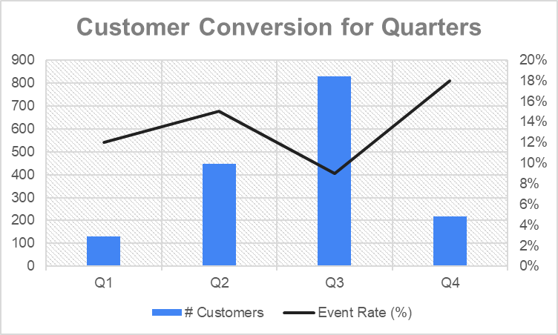
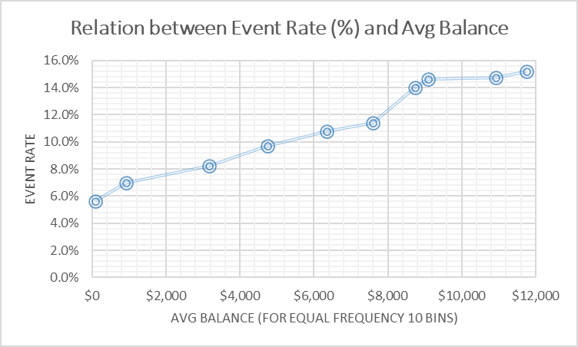
Analysis Results
ILLUSTRATION
Key Findings :
…
…
…
Key Findings :
…
…
…

Slide 7
Key Takeaways and Recommendations
Key Takeaways from the Analysis :
…
…
…
ILLUSTRATION
Final Recommendations :
…
…
…

Slide 8
Case study of the problem (1-Slide summary)
Key Considerations
Approach & Solution
Insights/ Recommendations
ILLUSTRATION

Slide 9


